Slide 1
PISA for Development
1st International Advisory Group Meeting
Expected results from the meeting
27 – 28 May 2014
Paris, France
EDU/DCD
Notes:
Intro remarks
My colleagues and I are delighted and couldn’t be more thrilled to have this opportunity to present the PISA for development project to this meeting.
The cooperation that this represents between the OECD Directorates for Education and Skills and Development Cooperation and with our development partners and technical partners and with the countries represented in this meeting is very welcome
But for us as staff of OECD’s Education and Skills and Development Co-operation Directorates the PISA for development project is an exciting addition to our programme of work. And what we would like to do now is take you through the background to the project, the aims of the project and what it will seek to deliver over the coming three years.

Slide 2
PISA for Development International Advisory Group Meeting
Expected Results from Meeting
Review and formal adoption of the Terms of Reference for the International Advisory Group (IAG), including annual report content, and election of two Co-Chairs
Up-date on progress with the PISA for Development project, including timeline
Discussion and agreement on the main technical issues to be addressed and the best options for tackling these, based on the first set of technical papers that have been commissioned

Slide 3
Expected Results from Meeting, continued …..
Discussion and agreement of the main components of the draft Terms of Reference for the International Contractor(s) to be commissioned by the OECD for the project implementation and next steps for this process
Review of the capacity needs-analysis conducted with participating countries and the design of the capacity-building programmes
Review of the proposal for an independent review of the project to be conducted in 2016/2017
Draft summary record and next steps agreed.

Slide 4
Day One: sessions
International Advisory Group ToR, election of Co-Chairs, Annual Report Content
Project up-date and timeline for project implementation
Discussion of the three technical strands of work based on the first set of technical papers that have been commissioned

Slide 5
Day Two: sessions
Discussion and agreement on the main components of the Terms of reference for the International Contractor(s)
Capacity needs analysis and the design of capacity building programmes for participating countries
Terms of Reference for an independent review of the project in 2016/17
Next steps and meeting conclusion

Slide 6
Key documents in folder
Agenda
Participants list
Draft ToR for International Advisory Group and proposed content for annual report
Draft ToR for Technical Advisory Group – for noting and written feedback
Power points
Project timeline and indicative implementation schedule
Three expert papers
Paper on Components of ToRs for International Contractor(s)
Draft ToR for independent review of the project
Draft summary record of the technical workshops, April 2014
Draft engagement and communication strategy – for noting and written feedback

Slide 7
PISA for Development
1st International Advisory Group Meeting
Terms of Reference for the IAG
27 – 28 May 2014
Paris, France
EDU/DCD

Slide 8
PISA for Development International Advisory Group
Main Phases and Governance
Partnership with and ownership by 5 to 7 participating countries
International Advisory Group
International and National Implementation
Technical Oversight and Coordination

Slide 9
PISA for Development International Advisory Group Meeting
Expected Results from Meeting
Review and formal adoption of the Terms of Reference for the International Advisory Group (IAG)
Election of two Co-Chairs
Agreement of annual report content
Date and venue for next meeting

Slide 10
International Advisory Group: ToR
To provide substantive and strategic guidance to the project
Membership
Advisory Group Decisions
Meetings and Chairpersons
Secretariat

Slide 11
Annual report format
From 2015 onwards, a progress report:
actual outputs compared to planned outputs
summary of the use of funds compared to budget,
explanation of major deviations from plans,
assessment of problems and risks,
assessment of the need for adjustments to activity plans and/or inputs and outputs, including actions for risk mitigation,
assessment of achievements in relation to project purpose

Slide 12
PISA for Development
International Advisory Group
Project up-date
27-28 May 2014
OECD Secretariat

Slide 13
PISA for Development Initial Technical Meeting, June 2013 - Conclusions
Expressed unanimous support for the PISA for Development project
Acknowledged the unique value that PISA has as an international benchmarking tool for quality and equity in schooling and for guiding policies for system improvement.
Agreed a set of next steps for taking the project forward.

Slide 14
Next steps and actions taken (1)
Next steps | Actions taken
OECD to consult further on and then commission technical papers and to prepare ToR for international contractor | Expert paper on enhancing the descriptive power of PISA cognitive instruments – Ray Adams and John Cresswell Expert paper on enhancing PISA’s contextual questionnaires – Doug Willms and Lucia Tramonte Expert paper on developing methods and approaches for including OOSC in data collection and assessment – Roy Carr-Hill Technical workshops: 8-11 April (Washington) and October 2014 (Montreal) Expert paper on system level data –UIS Expert paper on other assessment programmes – ACER

Slide 15
Next steps and actions taken (2)
Next steps | Actions taken
OECD to write to countries with proposed agreement for participation in the project Countries to respond to OECD’s proposed agreement and to confirm their participation Participating countries to nominate NCs and NPMs | OECD has written to Cambodia, Ecuador, Guatemala, Rwanda, Senegal, Sri Lanka , Tanzania and Zambia with proposed participation agreements Ecuador has signed an agreement with OECD. Senegal and Zambia are finalising draft agreements with OECD – these countries have nominated NCs and NPMs Guatemala, Rwanda and Tanzania processing agreements with OECD and should be next to finalise Cambodia is processing agreement through its systems – this country has yet to confirm funding. Sri Lanka has been unable to confirm funding at this stage.

Slide 16
Next steps and actions taken (3)
Next steps | Actions taken
Participating countries establish agreements with development partners regarding contributions and support (e.g. international costs, in-country costs and activities) OECD to confirm with development partners agreements for support to the project – general contributions and country-specific contributions | Senegal has established agreements with the World Bank and France (AFD). Guatemala has established agreement with IADB Zambia has established agreements with the World Bank and DFID Rwanda and Tanzania have established agreements with DFID Cambodia is in the process of establishing agreements with the World Bank OECD has signed grant agreements with Norway (Norad), UK (DFID), Germany (BMZ/GIZ) and Korea. Japan (JICA) and Ireland (Irish Aid) have indicated that they will provide support.

Slide 17
Next steps and actions taken (4)
Next steps | Actions taken
OECD to collate information regarding capacity-building experiences, specifically regarding student assessment and use of results | ToR and plans for a high level report on the experiences of non-OECD countries participating in PISA prepared and agreed with the World Bank: Marlaine Lockheed approached to lead the work. High level report to be launched in early 2015 and to inform peer-to-peer learning activities in 2015, 2016 and 2017 Capacity needs analysis completed for Ecuador, Senegal and Zambia. Capacity needs analysis planned for Rwanda and Tanzania in July and Guatemala in August. Capacity building programmes designed for all participating countries by December 2014

Slide 18
Next steps and actions taken (5)
Next steps | Actions taken
OECD to confirm with other agencies arrangements for technical partnerships and collaboration | Technical partnerships and collaboration established with UIS and UNICEF, particularly on OOS 15 year-olds and system level data (UIS) Dialogue continued with PASEC, SACMEQ and LLECE with a view to establishing technical partnerships and collaboration ToR for a review of assessment programmes prepared and agreed with World Bank – ACER to be commissioned Contributions to LMTF, education in the post-2015 agenda and EFA through UNESCO/UIS and EFA SC and EFA TAG Collaboration with EFA GMR

Slide 19
Next steps and actions taken (6)
Next steps | Actions taken
First meetings of International Steering Group and Technical Advisory Group (including capacity-building) | The first meeting of the International Advisory Group from 27-28 May 2014. First meeting of the TAG planned for November 2014, following appointment of IC(s) – ToR for TAG included in folder for noting and written feedback

Slide 20
Next steps (7)
Tendering process to commission International Contractor (s) by OECD to support project implementation
Project implementation:
Design, planning and coordination (including capacity assessment, capacity building planning for participating countries and project implementation plans);
Technical development
Field trials and main data collection;
Analysis and reporting
Post-pilot governance

Slide 21
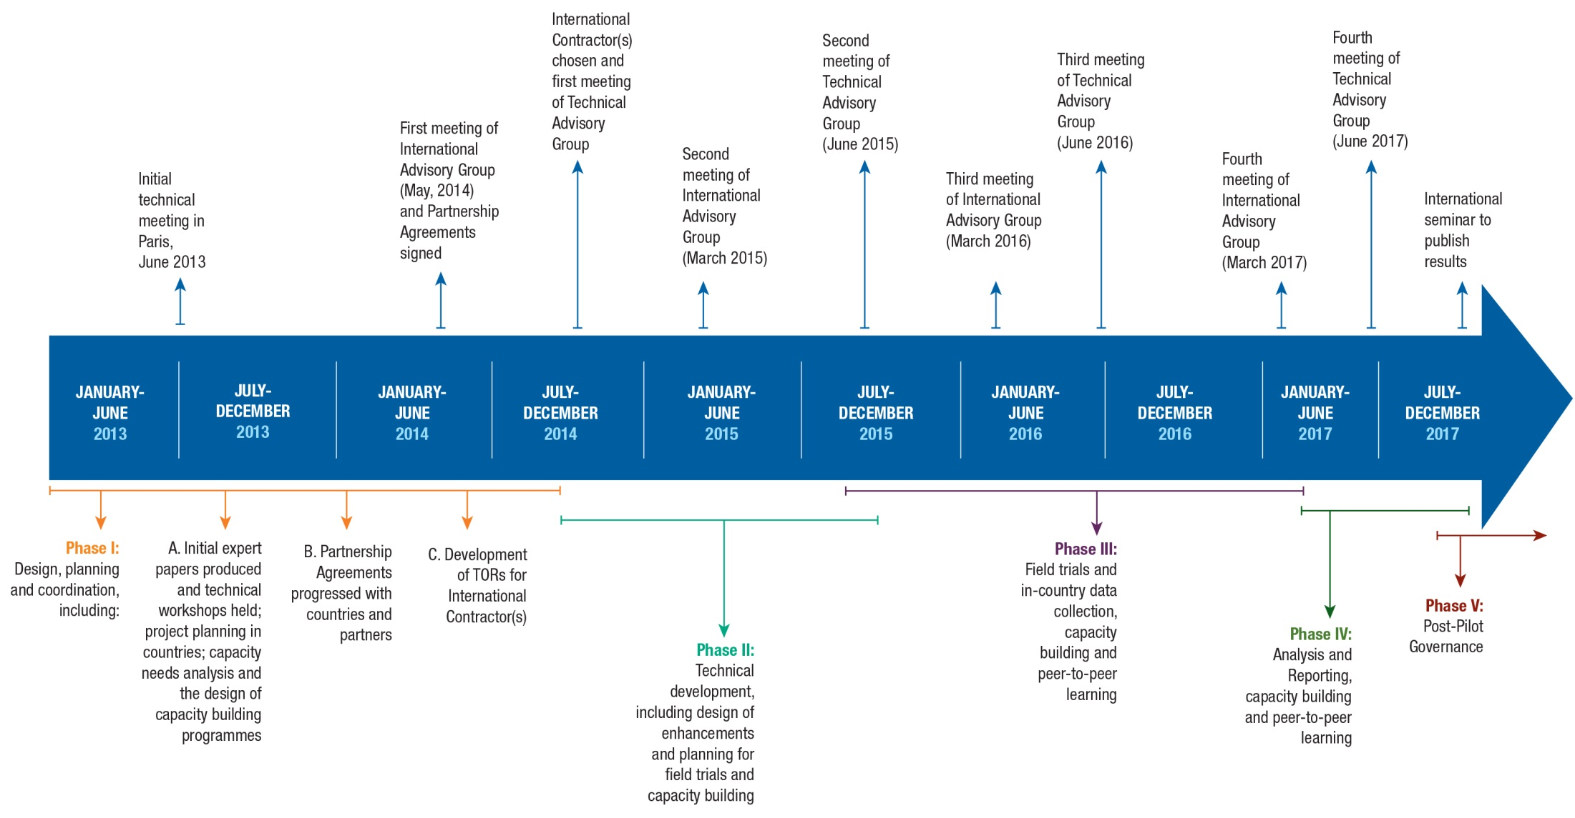
PISA for Development: Prospective Timeline – ^{Meetings & Phases}
Notes:
The five phases of the project will, in reality, overlap with each other.
The final phase, post-pilot governance, will extend beyond the project.
There is scope for holding additional meetings of the International Advisory Group and Technical Advisory Group if these are required.

Slide 22
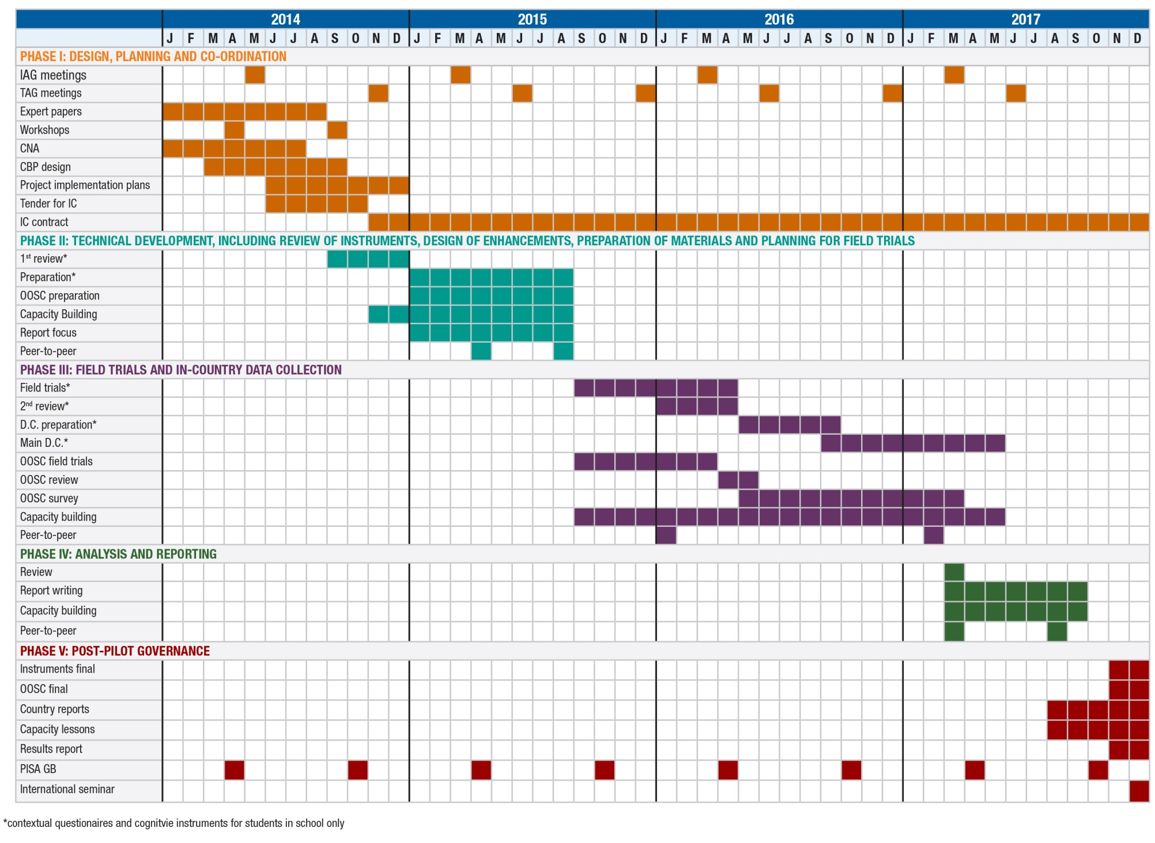
PISA for Development: Initial Implementation Schedule

Slide 23
PISA for Development: Preparation of Cognitive Instruments
Ray Adams & John Cresswell

Slide 24
The Constraints and Requirements
Direct comparability of PISA for Development and PISA
Use of PISA framework
No new test material development

Slide 25
Ensuring Comparability
Standards should be adhered to (e.g.)
Translation and adaptation
Sampling standards
Testing administration conditions
Do not compromise the assessment
Full range of content
Full range of difficulty

Slide 26
Ensuring Comparability
Design features should not be compromised
Population definition
Content coverage
Test design
Psychometric standards

Slide 27
Use of Existing Framework
It might be expected that the areas currently included for assessment which are seen as priorities by OECD countries may not coincide with the areas that are seen as priorities for developing countries.

Slide 28
No New Items
The available secure item pool has an information profile that does not match the likely proficiency profile in candidate PISA for development countries.
Inefficient
Unpleasant testing experience

Slide 29
No New Items
Drawing upon easy items only - it appears that test designers will face challenges in building a test that matches the framework specifications.

Slide 30
No New Items
No opportunity to better describe low ends of the scale
at least from PISA data or items
Related Observations
The current PISA described proficiency levels in reading do not provide enough useful information for many developing countries - making it difficult for policy makers to identify and implement remedial interventions focused on their students' weaknesses.
In mathematics, in some countries, nearly half the students are below the lowest level for which PISA can describe student capacity.

Slide 31
Main technical challenges and options for addressing these
6 main technical challenges facing the project
Options are available for addressing all of these
Opportunities for building on existing work and establishing links between current efforts and PISA for Development

Slide 32
Challenges to be addressed by the project -- 1
Poor fit of the scaling model and construct variation across countries
What are the potential implications
e.g. a study of (quantitative) impact on results
What are the alternatives
Basket of goods approach?
Other scaling models?
Selecting a subset of items that do fit

Slide 33
Challenges to be addressed by the project -- 2
Contextual appropriateness
Potentially related construct variation
Pros and cons of approaches to item selection
e.g. Trial all available secure items
Trial appropriately targeted secure items
Reduce the items set further by dropping items based upon a-priori evaluation of appropriateness

Slide 34
Challenges to be addressed by the project -- 3
Targeting concern
Develop ways of quantifying the impact of targeting issues
e.g. impact on reliability and analytic power
Develop test designs that could address the issue
e.g. uneven rotation
include national supplements

Slide 35
Challenges to be addressed by the project -- 4
Dealing with reliance on existing framework
Impact on value of the results
How can participants be given an opportunity to comment on the framework and review it against their educational goals? What can be done with such opportunities?
e.g. Feed into future framework development
Underpin some supplementary data gathering

Slide 36
Challenges to be addressed by the project -- 5
Better describe level one performance
Possibility of enhancing the descriptions by appealing to data that is external to PISA

Slide 37
Challenges to be addressed by the project -- 6
Evidence of comparability with PISA
What can be done to document the comparability of PISA for Development and PISA?
e.g. Cost benefit analysis of a linking study

Slide 39
Getting Started
Contextual Questionnaires for the PISA for Development Study
J. Douglas Willms & Lucia Tramonte
Notes:
39

Slide 40
Measuring
What Counts
Aims:
To describe the technical and related issues to be addressed in enhancing the PISA contextual questionnaires and data collection instruments for the PISA for Development (PfD) study to make them more relevant to some of the least economically developed countries in the world.
To identify the issues, options and possible ways forward.

Slide 41
Raising and Levelling the Learning Bar
Objective
Current
Student's Performance
Student's Socioeconomic Status
Students from all backgrounds improve their performance, while those
from less advantaged backgrounds show the largest improvement.

Slide 42
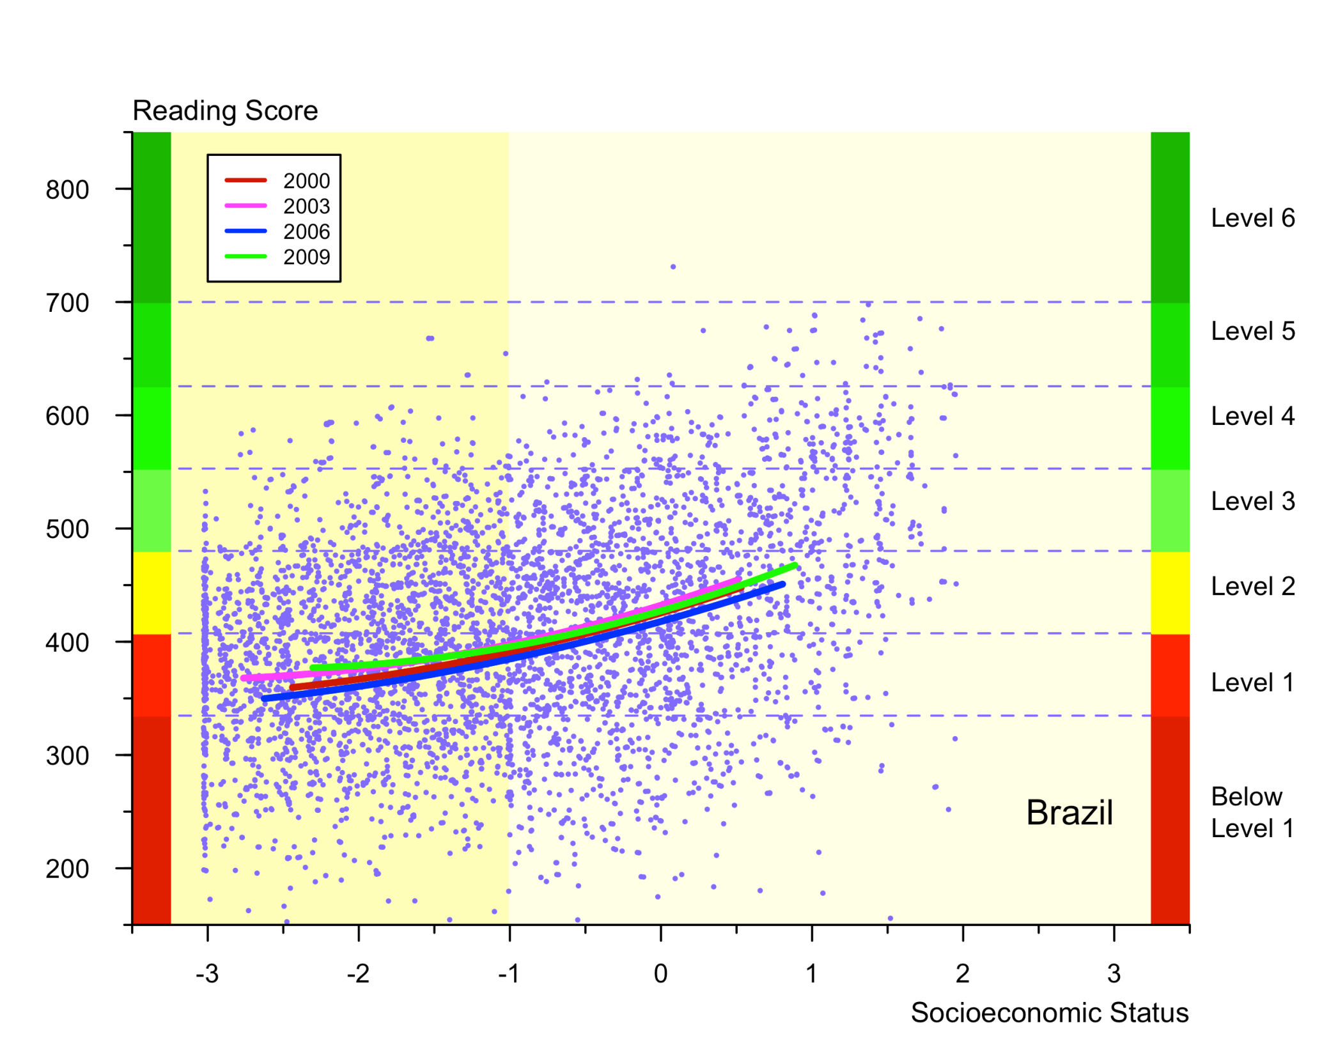

Slide 43
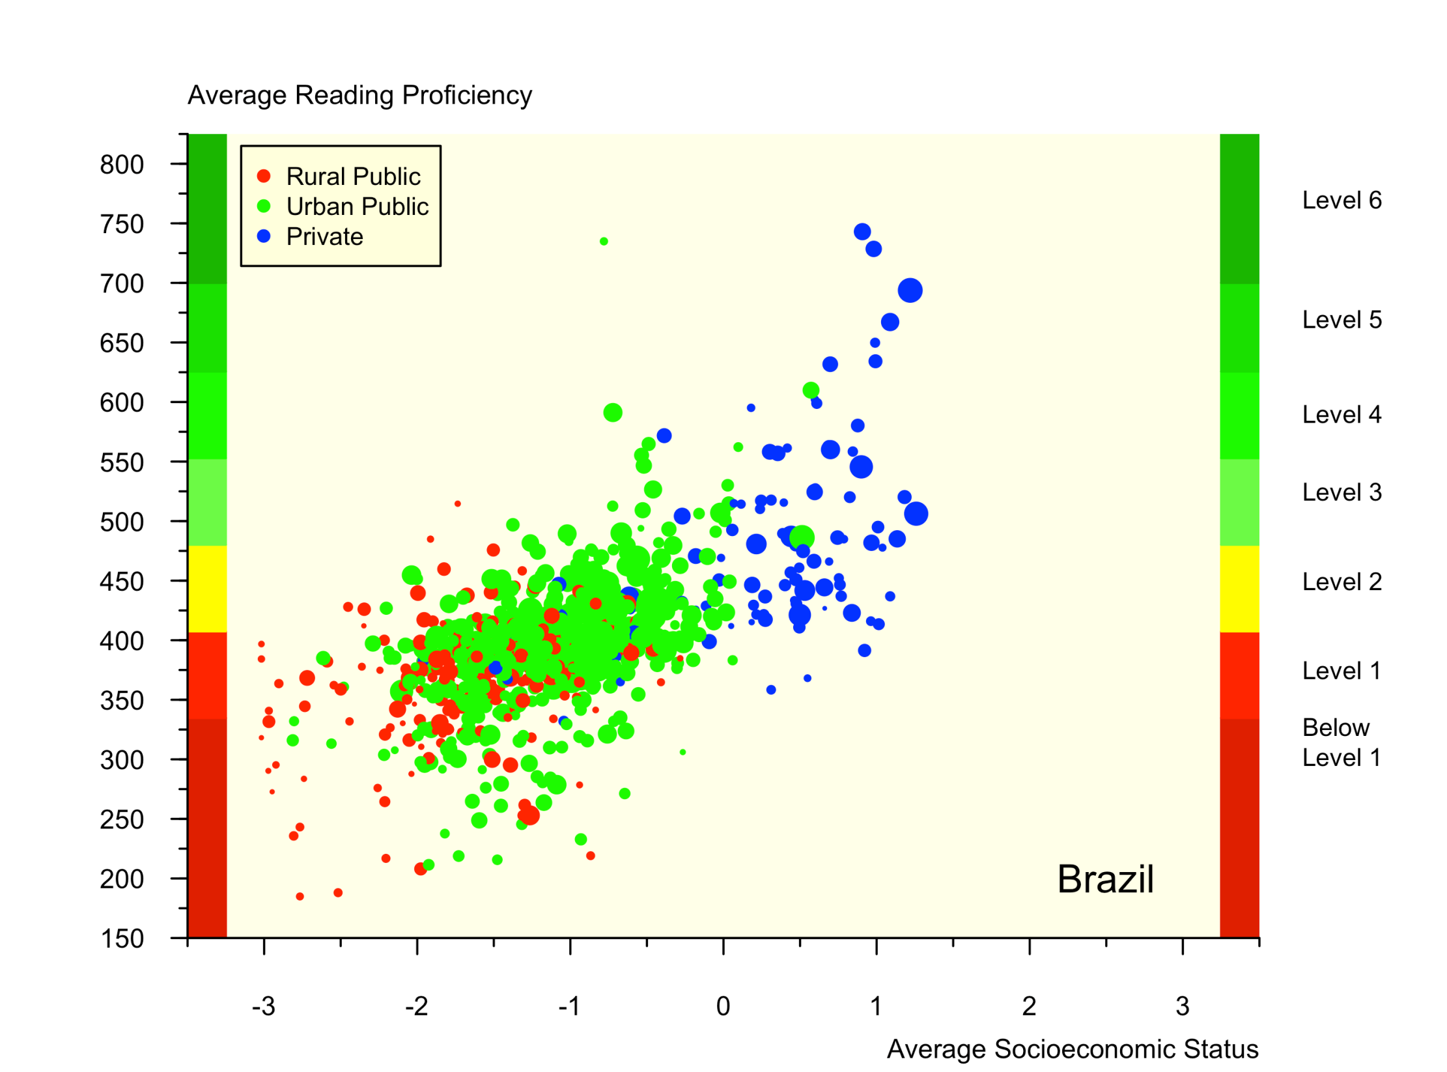

Slide 44
Seven Key
Themes
for
Enhancing
the
Contextual Questionnaires

Slide 45
Seven Key Themes
Based on:
 a model of learning focused on factors that explain student performance
 consideration of policy frameworks
 a review of literature
 an analysis of other international surveys
 previous analyses of PISA data
 discussions with partners at the Washington workshop

Slide 46
Seven Key Themes
 Early Learning Opportunities
 Language at home and school
 Family and Community Support
 Quality of Instruction
 Learning Time
 Socioeconomic Status
 School Resources

Slide 47
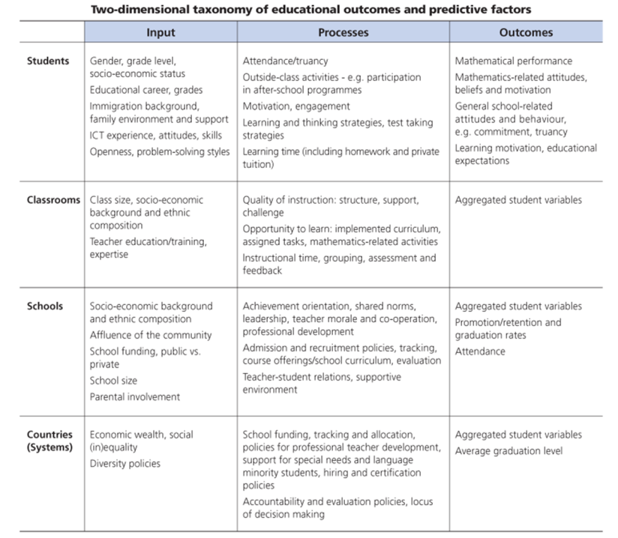
All seven of the themes are situated in the current PISA framework

Slide 48
Measurement for five themes can be adapted with relatively minor changes:
 Early Learning Opportunities
 Language at home and school
 Family and Community Support
 Quality of Instruction
 Learning Time
Measurement for two themes require more extensive adaptation:
 Socioeconomic Status
 School Resources

Slide 49
Early Learning
Opportunities
Currently: There are two measures on early learning opportunities in PISA, which pertain to school readiness and whether the child was read to during the early years.
Issues: We do not have reliable information on the reliability of retrospective student data. If there is to be a common parent questionnaire, data could be collected from the parents.
Decision: Should we extend the student questionnaire to include more detailed data about the students’ pre-school experiences and early grade repetition?

Slide 50
Currently: PISA includes a question about the language spoken at home.
Issues: We would also like to have data on other languages the student speaks and the student’s familiarity with the language of the test. At the country level, we would like to have data on the structural features of the school system regarding the language of instruction during the primary school.
Decision: Should we extend the student questionnaire to include one or two more questions about other languages the student speaks and the student’s familiarity with the language of the test?
Language at Home
and at School

Slide 51
Family
and
Community
Support
Currently: In some cycles, PISA included measures of social and cultural communication with parents, cultural capital, and family involvement.
Issues: The student questionnaire could be extended and adapted with specific measures of parental involvement, social capital, and static and relational cultural capital. We could also capture data on community involvement in the school with the school questionnaire.
Decision: Should we extend the student questionnaire to include a more detailed account of parental involvement, social capital, and static and relational cultural capital? Should we modify the school questionnaire question on who has responsibility for various tasks?

Slide 52
Currently: The PISA framework includes questions about classroom context (e.g., classroom disciplinary climate and teacher-student relations) and questions about the nature of classroom instruction (e.g., time spent with direct instruction and questions about “cognitive activation”).
Issues: We need data on the extent to which class time is spent in independent activities, such as working in workbooks versus small group activity and whole-class teacher-centered instruction. The significant challenge for collecting data on quality of instruction is that it needs to be subject-specific.
Decision: Should we extend and modify the student questionnaire to include more questions about quality of instruction?
Quality
of
Instruction

Slide 53
Currently: The PISA student questionnaire includes a set of questions aimed at estimating the learning time devoted to particular school subjects.
Issues: Learning time could be assessed more thoroughly with some measures of how students spend their time in and out of school. The measure of school attendance could also be enhanced. Students’ participation in the labour market also needs to be captured.
Decision: Should we extend and modify the student questionnaire to include more questions about learning time outside of school and school attendance?
Learning
Time

Slide 54
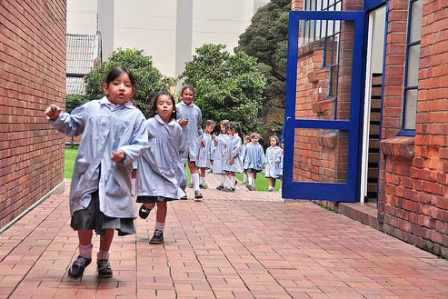
Socioeconomic Status
Currently: The PISA measure of SES, called ESCS, is based on three measures: home possessions, parents’ level of education, and parents’ occupation.

Slide 55
Socioeconomic Status
Issues: The PISA measure of SES was not designed to accurately assess the socioeconomic circumstances of children living in poverty.
One strategy is to extend the current indicators of PISA ESCS to include items at the lower end of the SES scale.
Another strategy is to develop one or more new indicators of SES that apply to children living in poor families. This is different conceptually than simply extending the existing SES scale at the lower end in that poverty is a fundamentally different construct.
For example, we could assess:
a. whether students’ had access to basic necessities at home;
b. the extent to which parents were literate and engaged in reading activities;
and
c. the extent to which the parents were participating in the labour force.
Collecting data for the second strategy would likely require a common parent questionnaire or interview.

Slide 56
Socioeconomic Status
Decision: Should we adopt the first strategy (extend the current indicators of PISA ESCS to include items at the lower end of the SES scale) or the second strategy (develop one or more new indicators of SES that apply to children living in poor families).

Slide 57
Currently: The PISA school questionnaire includes a question about whether a lack of certain resources impedes student learning.
Issues: The effects of school resources on student outcomes depends on whether the resource is available in the school, and if so, whether students have access to it and use it effectively. For PfD countries, the measure of school material resources needs to include very low levels of school resources, and make a clear distinction between material resources, schooling processes, teachers’ working conditions and human resources.
Decision: Should we extend and modify the student and school questionnaires to include more questions about school resources, or, alternatively attempt to use countries’ system-level data to assess school resources?
School Resources

Slide 58
Seven Themes – Seven Decisions
1. Should we extend the student questionnaire to include more detailed data about the students’ pre-school experiences and early grade repetition?
2. Should we extend the student questionnaire to include one or two more questions about other languages the student speaks and the student’s familiarity with the language of the test?
3. Should we extend the student questionnaire to include a more detailed account of parental involvement, social capital, and static and relational cultural capital? Should we modify the school questionnaire question on who has responsibility for various tasks?
4. Should we extend and modify the student questionnaire to include more questions about learning time outside of school and school attendance?
5. Should we extend and modify the student questionnaire to include more questions about learning time outside of school and school attendance?

Slide 59
6. Should we adopt the first strategy (extend the current indicators of PISA ESCS to include items at the lower end of the SES scale) or
the second strategy (develop one or more new indicators of SES that apply to children living in poor families), or
a combination of these two strategies (i.e., extend the current indicators of PISA ESCS to include items at the lower end of the SES scale and develop one or more new indicators of SES that apply to children living in poor families)
7. Should we extend and modify the student and school questionnaires to include more questions about school resources, or, alternatively attempt to use countries’ system-level data to assess school resources?
These changes need to consider the length of the questionnaires, such that their overall length is comparable to that of the main PISA study. Therefore, further decisions will need to be made regarding potential topics to be dropped from the PfD framework.
Also, consideration will need to be given as to who the best informants are for each theme, which has implications for the types of questionnaires (i.e., student, parent, teacher, and school) to be used in the PfD study.

Slide 60
Counting, Finding, Persuading, Sampling, Testing and Treating Out-of-School Youth
for IAG Meeting 27th- 28th May, 2014
PISA for Development
by Roy Carr-Hill
Institute of Education, London
roy.carr_hill@yahoo.com

Slide 61
BRIEF
The aim of this strand is to develop a methodology and approach for incorporating Out-of-School 15 year olds (henceforth OoS15yo) . This is the first draft to set out the issues, and the reliability and validity of possible approaches to Tracking and Testing the OoS15yo.
It should be emphasised that the situation In respect of this strand is very different from the previous strands on Cognitive Dimensions and Contextual
Definitional problems of what counts as school and conversely what counts as being out-of-school
In the other two strands, the proposed alterations ‘slot into’ the overall PISA framework including manuals and standards. This is not the case here; the final paper and the proposed components of ToR will have to deal with implementation issues, manuals & standards

Slide 62
BACKGROUND:
KNOWLEDGE & WORK ON
OUT-OF-SCHOOL YOUTH

Slide 63
In and Out of Primary School
For the countries round the table, in 2013, the age ranges of compulsory education, of the primary cycle and gross enrolment rates in primary are as follows
Compulsory Primary GER
Age Range Age Range Percent
Cambodia 6-15 6-11 86.4
Ecuador 5-15 6-11 >99
Guatemala 6-15 7-12 85.0
Rwanda 7-12 7-12
Senegal 6-16 7-12 91.4
Tanzania 7-13 7-13
Zambia 7-13 7-12 66.6

Slide 64
In and Out of Secondary School
Secondary Lower Sec 000s of OoS
Age Range GER % Adolescents
Cambodia 12-17 59
Ecuador 12-17 97 65
Guatemala 13-17 71 165
Rwanda 13-18 47
Senegal 13-19
Tanzania 14-19 47
Zambia 14-18 70

Slide 65
Which Groups are Out-of-School
UIS and the GMR/WIDE team have carried out extensive analysis of the data available to them – some of it presented in the paper - and the overwhelming impression from their analyses are that
Many 15 year olds are out-of-school
Those out of school are poorer, mainly rural
The most disadvantaged are poorest girls
But there are two VERY important caveats…..

Slide 66
First Caveat: What Counts as Being ‘In’ or ‘Out’ of school
The CREATE team has developed a model of zones of exclusion from education (Lewin 2007a). In each zone the patterns and causes of exclusion from education are likely to be different. They may also differ from community to community.
The model charts participation by grade and identifies different groups of children of school age that fail to sustain access to basic education
UIS/UNICEF have developed an alternative version as part of their Out-Of-School Initiative based on age rather than grade

Slide 67
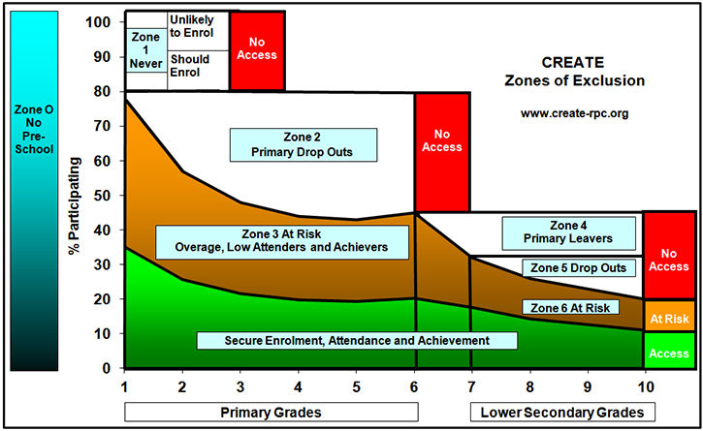

Slide 68
UNICEF/UIS OOSCI 5DE
1. Pre-primary school age children not enrolled in pre-primary or primary.
2. Primary school age children not enrolled in primary nor at a higher level.
3. Secondary school age children not enrolled in secondary nor at a higher level.
4. Children enrolled in primary school at risk of dropping out.
5. Children enrolled in secondary at risk of dropping out.
But neither of these approaches provide guidance on how to count, locate or find OoS15yo.

Slide 69
Schooling and Human Rights
Both the UNICEF/UIS initiative and the CREATE model are based on the right of children to a basic education, and so are ‘school-based’.
The term ‘exclusion’ - implying a positive or negative decision by schools is not appropriate for those who drop out for their own reasons.
Human rights discourse should frame policy dialogue, but it is not clear that they should:
(a) equate basic education ONLY to school;
(b) over-ride individual choice to leave after primary school (as happens, e.g. in Cambodia);
(c) determine empirical investigation of how many and which groups are out of school.

Slide 70
Second Caveat: Groups Omitted or Systematically Uncounted in Household Survey Data (A)
The natural implication of testing samples of all 15yo – including OoS15yo – is that national estimates could be made for all children.
This means that, at least approximately, we have to estimate numbers and distribution of OoS15yo.
But most data come from household surveys which are not appropriate for capturing information on the marginalised/most vulnerable.
By design, they exclude the homeless, those in institutions (hospitals, prisons, refugee camps), the mobile (nomads/pastoralists/ travellers).

Slide 71
Groups Omitted or Systematically Uncounted in Survey Data (B)
In practice, they tend to exclude those in fragile, disjointed households, those in urban slums and those in insecure areas*
Those six categories constitute a pretty good ostensive definition of the poorest of the poor
There are two other groups of adults and children who may be ‘hidden’ in households:
Those who are illegally resident
Those who suffer discrimination e.g. disabled
*This will also be a problem for in-school assessment

Slide 72
Household Survey Sample Design
My estimate (Carr-Hill, Compare, 2012) doubles the number OoS, based on the exclusion of between 300-500 million from the sampling frames of standardised household surveys (Carr-Hill, World Development, 2013)
In addition, the sample designs of DHS/MICS is based on cluster samples, based in turn on geographical population estimates. But even in non-nomadic societies, there can be substantial movement between rural areas because of land degradation which means that the sampling frames may miss the poorest

Slide 73
SUMMARY
1. Analysis of data shows: many 15yo are actually in primary school; OoS15y are poorer mainly rural; poorest rural girls are most disadvantaged
2. All forms of organised NFE education should be included in the definition. Pilot countries need to develop a comprehensive catalogue
3. Survey findings are taken as accurate estimates when they are in fact biased under-estimates of the marginalised and vulnerable
4. OoS15y should be seen as a population sub-group not as being solely defined in terms of their relation to school

Slide 74
ISSUES AND POSSIBLE SOLUTIONS

Slide 75
COUNTING AND LOCATING
DO NOT START AT THE SCHOOL GATES
Those OOS15yo are there possibly to sell, possibly to meet a boyfriend/ girlfriend, possibly to meet a younger brother or sister but NOT to constitute a sampling frame for PISA
The basic problem for estimating their numbers is that the age-specific population estimates in many of these countries are very suspect
Most of the marginalised in the countries around the table will be found among the isolated rural poor and informal settlements/ urban slums

Slide 76
Initial Guidance on Defining OoS15y (A)
How Out-Of-School children are defined in each country directly impacts the overall count of OoS15y, who to target and where to find them, and the strategy/incentives to achieve a cost-effective response rate.
There are multiple and conflicting estimates of the number and share of OoS children
There has to be an agreement on how to treat 15yo where the compulsory age range does not include 15yo.

Slide 77
Initial Guidance on Defining OoS15y (B)
There have to be at least three modifications to the standard PISA procedures:
first, compile a comprehensive catalogues of NFE which will count as equivalent to ‘school’;
second, report results for in-school 15yos according to grade and OoS15yo according to highest grade level achieved or attained;
third, some 15yos may be registered in a school but not actually attending (at least on the day of an interview); there will have to be an agreed set of criteria for allocating such respondents as ‘in-school’ or ‘out-of-school’.

Slide 78
COUNTING AND LOCATING
ISSUES | POSSIBLE SOLUTIONS
OoS15yo are mostly a marginalised & vulnerable population sub-group | Focus attention on isolated rural poor and informal settlements/ urban slums
Age-specific population estimates are suspect because birth registration is low | * employ local expert knowledge to estimate size and location of groups missing from survey sampling frames; * adjust survey estimates accordingly
Defining OoS15yo given low levels of school attendance | Criteria needed for deciding the status of a 15yo interviewed at home who claims to be in school

Slide 79
Finding and Identifying
Once found, it should be possible to interview the isolated rural poor.
Any Internally Displaced Persons may be very reluctant to take part in a (semi-) official exercise.
An alternative approach in urban areas is to search for working youth and interview them as per the STEPS programme; but employers may not be very cooperative.
In fact, data suggest that most OoS15yo are working at home or with household members.
There need to be special arrangements for those in institutions, living on street as market/ street sellers – the latter much more difficult to find.

Slide 80
Constructing a Sampling Frame
Assuming locations/ employers have been identified, a sampling frame of 15 year-olds (15¼ to 16¼) needs to be constructed.
One possibility would be to carry out a mini-census in areas identified by key informant:
this is resource intensive but there is possibility of using citizen volunteers as in DRC and India, although this needs to be very carefully monitored;
but where parents are highly concerned with safety of children, this could be difficult;
my own experience is that the results are of doubtful validity because of ’empty’ households.

Slide 81
FINDING AND IDENTIFYING A SAMPLING FRAME
ISSUES | POSSIBLE SOLUTIONS
Population movement in rural areas because of recurrent drought | Re-listing sampled clusters, identifying households with 15yo; reviewing, adjusting for differences from census enumeration counts
OOS15yo working at home in urban areas | Listing of sampled clusters, identifying households with 15yo.
OOS15yo working outside home, on street | Interview in evening or at night
Non-household populations | Capture-recapture methods.
Reluctance of IDPs to be identified
Different sub-groups within OOS15yo | Adjust sample numbers of different groups to adjusted estimates of size

Slide 82
SAMPLING AND PERSAUDING
Taking part in an achievement test will not be at the top of the agenda of these youth.
Will they need to be paid to participate?
These OOS15yo are NOT in a classroom. Most will almost certainly NOT agree to come to a ‘testing centre’.
Most /all will therefore have to be interviewed on the street, a precarious (Valparaiso, Chile example) and expensive alternative.
Recruitment, selection and training of interviewers; important to emphasise sensitivity.
Interviewers work in pairs (UK example).

Slide 83
SAMPLING, PERSUADING AND INTERVIEWING
ISSUES | POSSIBLE SOLUTIONS
Not possible to carry out mini-census | Snowball from first group encountered at each identified site
Taking part in achievement test not top of agenda of OoS15yo, especially as many may have recently left school with negative attitudes | Sensitivity of interviewers important part of recruitment, selection and training of interviewers Where OoS15yo working at home, explore ways of getting adults in household ‘on-side’ Where OoS15yo working in street, interview in evening if possible
Interviewing in possibly unsafe areas | Interview in pairs
Children in institutions | Special arrangements

Slide 84
Contextual Questionnaire and Treating in Analysis
Crucial for PISA is accurate age estimation: reliable in school if birth records have been presented, much more difficult and possibly biased in interview and self-report situation
Importance of detailed questions about NFE; a catch-all question will generate low response rate
Results not being combined with main samples
Not always clear that a single ‘SES’ construct is the most appropriate; it may be more helpful to use two or three dimensions

Slide 85
CONTEXTUAL QUESTIONNAIRE AND ANALYSIS
ISSUES | POSSIBLE SOLUTIONS
Estimating age accurately, and strong incentives for interviewers to include 13/14 and 16/17 yo | Country and site-specific event calendar to ‘frame’ age Statistical comparison of N of ‘hits’ of each interviewer with expected N of 15yo
Non-school learning experiences | Additional country-specific questions
Bias of self-reports of level of education | Cross-check sub-sample of responses with parental recall?
Appropriateness of poverty measure | Consider possibility of several dimensions
Treatment of different groups in analysis | Not being combined with main sample Breakdowns by school experience, rural/urban and females/males

Slide 86
Assessment: Design of Instruments
Language of instruction is irrelevant
Even if we get to testing, there will have to be filters:
Cannot assume literacy in any particular vernacular, therefore alternative graphic representations could be considered for maths (patterns and shapes) and science? SUGGESTION: Assessment of Comprehension could be through oral passages and follow-up questions

Slide 87
TESTING, DESIGN AND DEVELOPMENT OF ASSESSMENT INSTRUMENT
ISSUES | POSSIBLE SOLUTIONS
Mode of Testing | Possible use of mobiles
Language of Testing | Language of Communication not of instruction
Literacy in any particular vernacular cannot be assumed | Filters to identify best language to use, possibly through asking about how they text messages Low level reading components
Respondent unable to recognise single digit numbers | Explore graphic representations such as patterns and shapes used to assess non-verbal reasoning

Slide 88
Provisional Conclusions
COUNTING: Can probably estimate numbers OoS
FINDING: Can probably find and identify main clusters
SAMPLING: Constructing a sampling frame problematic in some countries
PERSUADING: Pressure from household adults? Incentives?
INTERVIEWING: Use of mobiles
ASSESSMENT: Any testing will probably require development of parallel visual and oral items
ANALYSIS: Specific attention to estimating age and context-specific poverty measures
alent to

